Slide 1
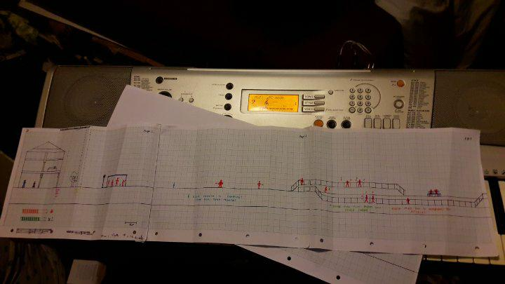
Level Design
Levels grouped into “Stages” based on story progression
These stages are made up of:
  A “beat –em-up” Level
  A platforming level
  A boss level (With an introductory platforming section)

Slide 2
Level Design
Levels are kept short and snappy to prevent over exposure to game play elements.
Minor adjustments to levels may include
  Auto-scrolling
  Stealth gameplay
  Challenge modes.

Slide 3
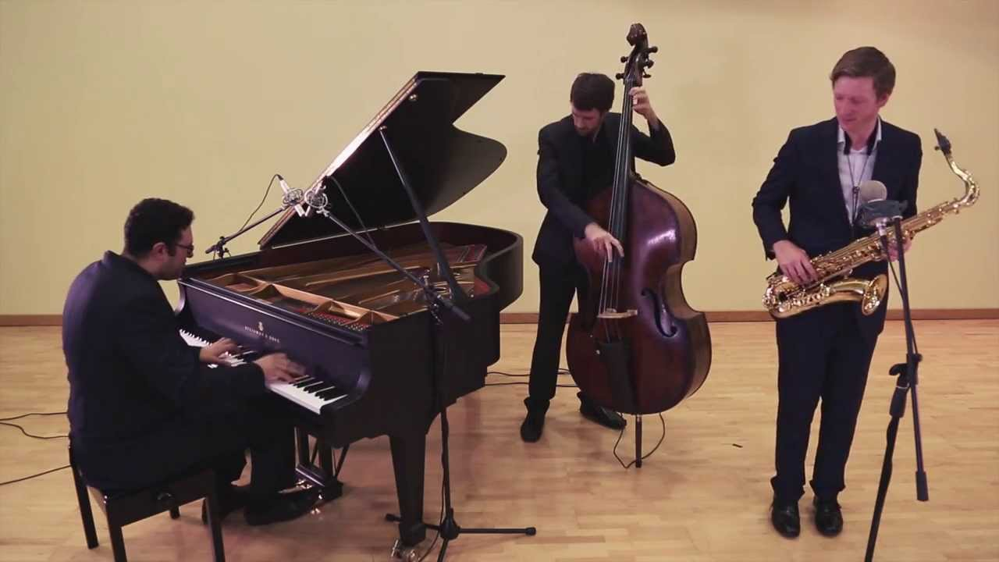
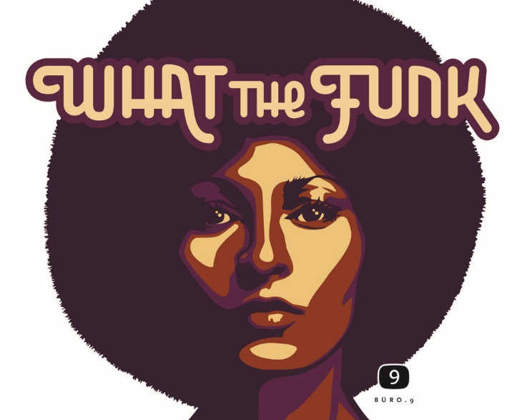

Music
The music is based on 40’s Noir and 60’s and 70’s disco and funk (mimicking the exploitation genre).
https://www.youtube.com/watch?v=nFvRvSxsW-I
https://www.youtube.com/watch?v=uwQ5VqRp5ps

Slide 4
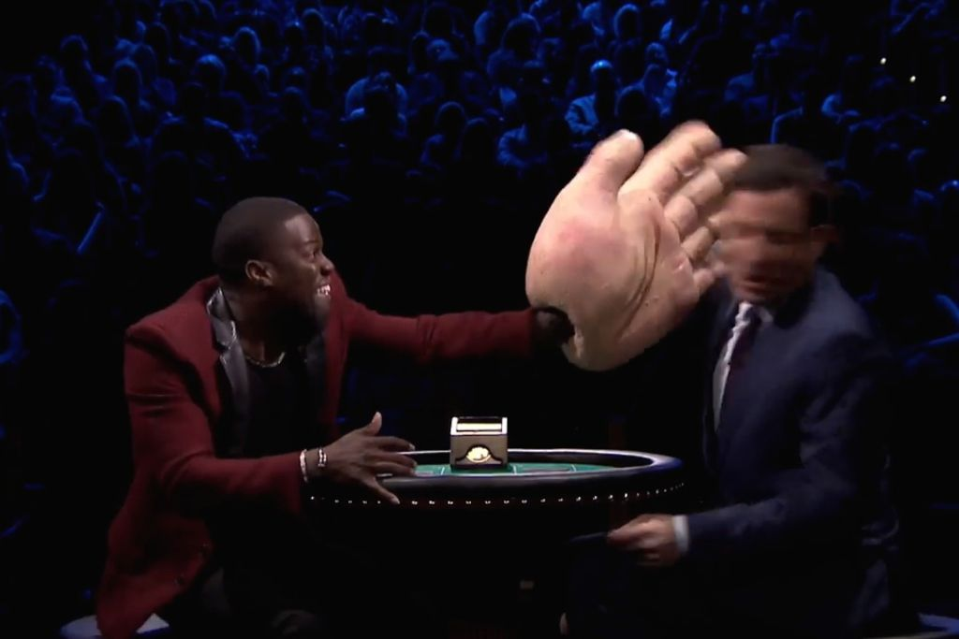
Sound effects
Sound effects include:
  Voice sounds from player and non player characters.
  Exaggerated collision sound effect.
  Pickup sound effects when collecting power-ups.

